Slide 1


DESIGN 1
Lesson 3: Independent Application: A Fully Connected Site
Ms. Abboud • Grade 9 - Design 1 • Term 1, Week 5

Slide 2
Learning Objectives
WALT - We Are Learning To
WILF - What I'm Looking For
Independently audit and fix my site's navigation.
Connect every page to every other page.
Navigation is present and identical across all pages.
Every link has been tested and works.

Slide 3
Frayer Model: Navigation (Review)
DEFINITION
CHARACTERISTICS
The system of links (often a menu) that lets a visitor move between the different pages of a website.
Usually a list of links; appears on every page; helps users move around.
NAVIGATION
EXAMPLES
NON-EXAMPLES
A menu bar with Home/About/Contact.
A single link buried in a paragraph.

Slide 4
National Identity Integration
UAE Government Digital Services: service teams test their websites so that no page is a dead end. Today you test your own site the same way.

Slide 5
STARTER
Can You Get Home?
Click through your own site right now.
Is there any page you can't get back to Home from?
Hook • Engage & Ask
5 - 10 minutes

Slide 6
LESSON CORE
I Do: Today's Challenge
Audit every page of your site like a visitor would.
Fix any missing or broken links, and make the menu identical on every page.
Stretch: link to a useful outside resource with target="_blank".
Gradual Release of Responsibility
30 - 40 minutes
Example: a stretch link to an outside resource
<a href="https://www.w3schools.com/html/" target="_blank">HTML Reference</a>
1 / 2

Slide 7
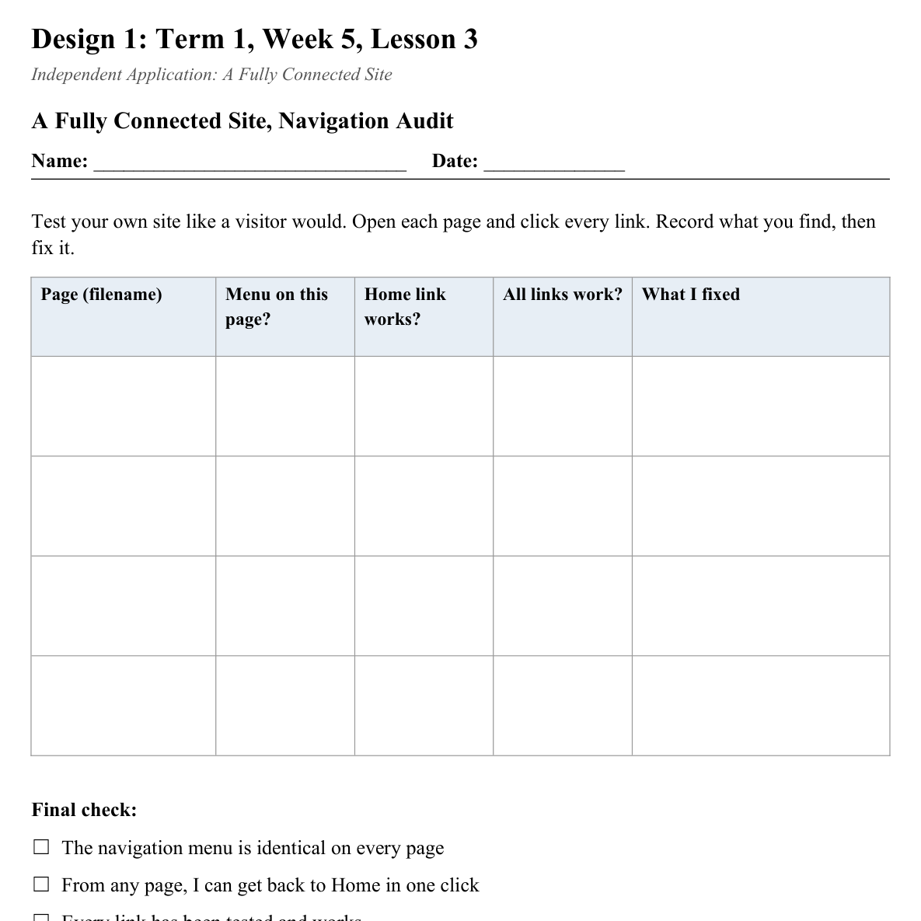
LESSON CORE
You Do: Audit & Fix
Use the Navigation Audit sheet to check every page, then fix what you find.
I'll be circulating for 1:1 help with tricky links.
Activity: A Fully Connected Site, Navigation Audit
Gradual Release of Responsibility
30 - 40 minutes
2 / 2

Slide 8
CLOSURE
Teacher Circulation
No formal exit ticket today. Teacher circulates for 1:1 feedback on navigation.
Transition & Extend
5 - 10 minutes

